Slide 1
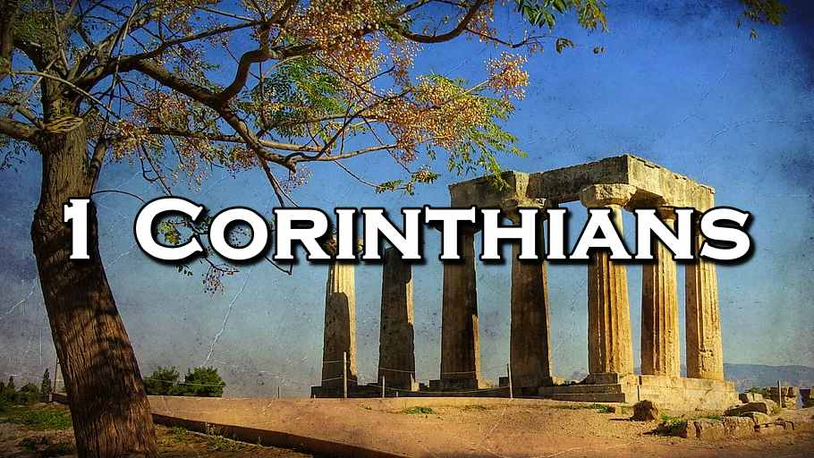
Opening Greeting And Prayer
Starting With Spiritual Riches
Week 51
10 May 2023

Slide 2

1 Corinthians Introduction
AUTHOR: Paul of Tarsus, the Apostle to the Gentiles, wrote First Corinthians on his third missionary journey five years after he founded the church in Corinth.
DATE AND PLACE OF WRITING: First Corinthians was written in Ephesus in the spring of A.D. 55. This would have been at the prosperous peak of Paul’s work in Ephesus. We know it was spring because it was just before Pentecost when this letter was written (I Cor. 16:8).
KEY VERSES: 1 Corinthians 1:10 “Now I plead with you, brethren, by the name of our Lord Jesus Christ, that you all speak the same thing, and that there be no division among you, but that you be perfectly joined together in the same mind and in the same judgment.”

Slide 3
1 Corinthians Introduction
CITY OF CORINTH: In New Testament times, Corinth was a locus of political power it was host to the surrounding regional governors. The city had been rebuilt by Julius Caesar in 44 BC and repopulated with freedmen from around the Roman Empire, which ended the desolation the city had endured at the hand of the Romans when it had been destroyed in 146 BC.
Corinth was a very diverse and pluralistic city; it was a booming place of commerce where many religions existed side-by-side, and many syncretistic belief systems resulted.
It lay on the isthmus connecting the southern mainland of Greece, from the Peloponnesian Peninsula, to the northern border of Greece and the provinces of Macedonia and Epirus, between the Adriatic Sea and the Aegean Sea.

Slide 4
1 Corinthians Introduction
CITY OF CORINTH: It was the capital of the Roman province of Achaia, Corinth was a wealthy city because of its strategic geographical location, and as a port city and commercial center it controlled two major harbors and command of the trade routes between Asia and Rome.
Corinth’s strategic location along both the overland and marine trade routes brought the city great commercial prosperity, that was increased even more by the city’s own bronze and terracotta industries.
As an indication of its commercial importance, in the first century, the city boasted a marketplace larger than any other marketplace in Rome.

Slide 5
1 Corinthians Introduction
CITY OF CORINTH: Along with economic prosperity came peace. And as it regain financial stability, Corinth again began to host, the Isthmus games, in which Greeks and Romans from all over the empire came together every two years to compete in athletics, drama, music, and oratory contest.
These games, held in their 18,000 seat outdoor theater, were not only popular but they were also known for their extravagance and licentiousness.
The games brought tourism, which combined with trade and travel, necessitated the establishment of a banking system that further increased the city’s wealth.

Slide 6
1 Corinthians Introduction
CITY OF CORINTH: The city housed numerous temples to various deities, the most prominent was the temple of Aphrodite, the Greek goddess of love.
The temple sat atop an 1800-foot promontory called the Acrocorinthus; and its 1,000 prostitutes came down into the city from their mountain temple at night.
The city was considered the center of immorality, sailors and traveling salesmen came to Corinth on holiday to spend money and find pleasure.
Corinth stood for everything that is sinful, it became so notorious that the term “Corinthianize” meaning “to live in debauchery,” became synonymous with the name “Corinth.”

Slide 7
1 Corinthians Introduction
CHURCH AT CORINTH: The Apostle Paul on his second missionary journey established the church in Corinth, he took extreme pride in his work as the wise architect of this church built on Christ as the foundation. So he spent 18 months in Corinth, preaching the Gospel and establishing a community of believers.
The church was known for its giftedness in spiritual matters, including speaking in tongues and prophecy.
However, it was plagued with problems, including interpersonal relationships, divisions over leadership, marital problems, lawsuits, sexual immorality, misconduct during the Lord’s Supper, and the list could go on and on.

Slide 8
1 Corinthians Introduction
CHURCH AT CORINTH: Despite these challenges, the Corinthian church was a vibrant and active church community that hosted the Apostle Paul on multiple occasions and continually supported his missionary efforts.
Overall, the Church of Corinth was a dynamic and complex community that faced many challenges but remained faithful and continued to grow and develop over the centuries.
It played a significant role in the spread of Christianity throughout Greece and beyond, and it was home to many prominent Christian leaders and theologians.

Slide 9
1 Corinthians Introduction
THEME OF EPISTLE: The themes of this letter revolve around Christian conduct in the local church and how it influences unity, discipline, and spiritual growth.
The overarching issue in the Corinthian church was “Progressive Sanctification,” the development of Holy character and the application of Christian principles and discipline on an individual and corporate level.
Immorality and disunity was destroying the Corinthians Christian witness. Paul was personally concerned about these problems, because the Corinthians knew the message of the Gospel and its purpose in their lives as individuals and as a corporate body.

Slide 10
1 Corinthians Introduction
PURPOSE OF THE EPISTLE: Paul wrote this letter to refute improper attitudes and conduct and to promote a spirit of unity among the believers in their relationships with one another and their corporate worship.
His goal was to make “Positional Sanctification” practical in the local church by providing guidance and instructions on restoring the church in areas of weakness, on correcting erroneous practices such as divisions, immorality, litigation in pagan courts, and abuse of the Lord’s Supper.
Lastly, Paul wanted to correct the false teaching concerning the resurrection; and to answer the questions addressed to him in a letter that he had received from the church.

Slide 11
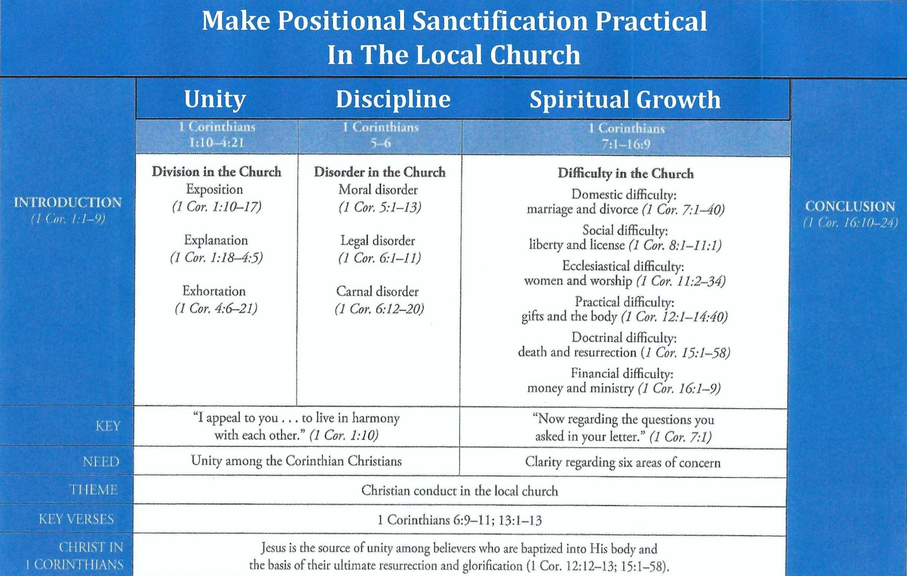
Purpose and Presentation
First Corinthians

Slide 12
1 Corinthians Overview
Paul’s first letter to the Corinthians continues to be timely for the church today, both to instruct and to inspire.
Christians are still powerfully influenced by our cultural environment, and most of the questions and problems that confronted the church at Corinth are still very much with us today.
This first letter to the Corinthians consist of seven sections, including a brief introduction; that focuses on developing a healthy church life – by addressing problems and by calling believers onward in sanctification and the proper exercise of spiritual gifts.

Slide 13
1 Corinthians Overview
Let familiarized ourselves with a “Broad Overview” of this first letter to the Corinthian church!
Opening Greeting and Prayer (1:1-9).
Rebuking Divisions and Folly (1:10 – 3:23).
Correcting Ills and Immorality (4:1 – 6:20).
Strengthening Family and Fellowship (7:1 – 10:33).
Ordering Church and Worship (11:1 – 14:40).
Concerning Death and Resurrection (15:1-58).
Concluding Instructions and Warning (16:1-24).

Slide 14
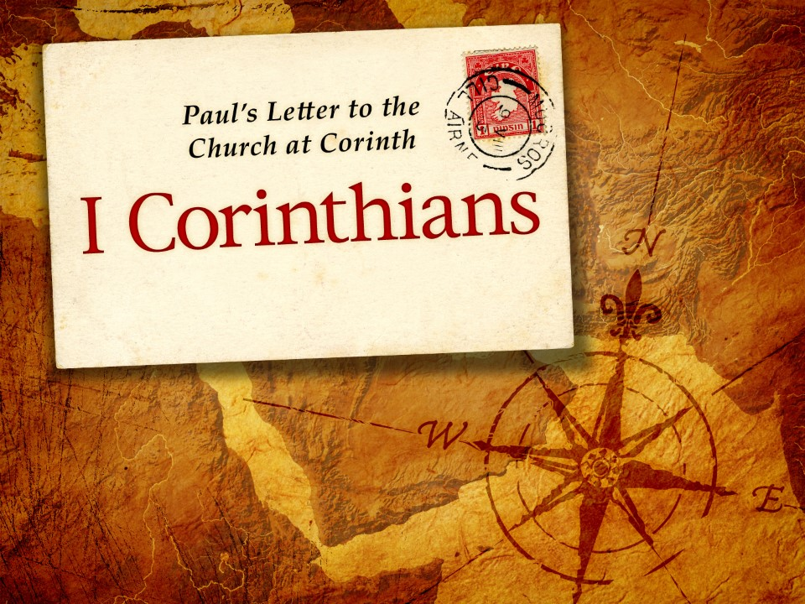
Starting With Spiritual Riches - 1:1-9

Slide 15
1 Corinthians - Lesson Overview
During our lesson tonight, “Starting with Spiritual Riches”, we are going to catch the first glimpse of the riches of the church in Corinthian (1:1-9).
In this opening greeting we learn:
The writer and the Recipients (1:1-3).
Original riches of the Church (1:4-7)
Promised reward for Endurance (1:8-9).
So when we see the depths to which the Church declined even in the midst of great spiritual wealth, this positive description serves merely as a solemn preamble to a sobering tragedy.

Slide 16
1 Corinthians - Lesson Overview
Swindoll … opens this study with the tragic story of the life of Edgar Allan Poe. “Raised by foster parents who loved him, received an education that matched his genius, few rivaled him as a literary critic, editor, poet and author. Poe’s works have left their mark on American literature and life.”
“After losing his young bride to tuberculosis, Poe descended into a deep pit of despair, which he attempted to assuage through drugs, alcohol, and the occult.
Depression and insanity plagued his life, eventually leaving him unconscious in the gutter of a windswept street in Baltimore. He never regained consciousness and died four days later.”

Slide 17
1 Corinthians - Lesson Overview
“Within forty years he literally went from riches to rags.”
Poe began his life with brilliance, giftedness, fame, opportunity, and riches. Yet the end of his life overflowed with bitterness, poverty, moral depravity, and spiritual destitution. From prestigious bard to penniless bum – that was the tragic tale of Edgar Allen Poe.
This ruinous journey from riches to rags happens not only to individuals but can also happen to churches.
The church at Corinth stands as a tragic example. Its rich beginning made it seem invincible.
A dynamic and diverse membership gilded with spiritual gifts at a crossroads of commerce and culture that poised them to make a powerful impact in the world.

Slide 18
1 Corinthians - Lesson Overview
Yet like Poe, within a brief period of time the church at Corinth declined into mediocrity and chaos, as the weight of sin pulled its members deep into the mire of shame.
Here, Swindoll reminds us that … “As the lights dim on our culture and our churches begin to look more and more like the disheveled, self-serving church in Corinth, Paul’s words to that fragmented church takes on greater import and more urgent practicality.”

Slide 19
1 Corinthians 1:1-3
¹Paul, called to be an apostle of Jesus Christ through the will of God, and Sosthenes our brother, ²To the church of God which is at Corinth, to those who are sanctified in Christ Jesus, called to be saints, with all who in every place call on the name of Jesus Christ our Lord, both theirs and ours: ³Grace to you and peace from God our Father and the Lord Jesus Christ.

Slide 20
1 Corinthians 1:1-3
As is typical of Paul in his epistles, he identifies himself in the opening verse, reminding the Corinthians of his position as an apostle of the Lord Jesus Christ (1:1).
The Corinthian believers knew him well since just a few years earlier he had helped them take their first steps in the faith.
Why would Paul need to remind them that he had been “called (kletos) as an apostle”?
Perhaps because of the occasion of this letter … this letter would necessitate a series of severe criticisms, rebukes, words of strong admonitions, and detailed instructions.

Slide 21
1 Corinthians 1:1-3
By reminding the Corinthians that he was not only their founding Pastor but also an “apostle” of the universal church, he would firm up his authority at a time when it most likely would be resisted.
The apostle Paul had seen the resurrected Christ with his own eyes and received his apostolic commission directly from the Savior Himself (Acts 26:13-19).
Who also confirmed it to the prophet Ananias (Act 9:15). Paul had the authority and the power to heal, to discern good and evil, and to speak boldly, free from doctrinal error (Act 9:22; 13:9-10; 19:11-12; 1 Cor. 2:13).

Slide 22
1 Corinthians 1:1-3
As an apostle, Paul answered to no higher human authority, only to God directly. He manifested a healthy independence. He valued God’s favor far more than the favor of men (Gal 1:10).
Paul also includes in this greeting, “Sosthenes our brother” (1:1). While we are not sure of the role he played in writing this letter, it is believed that he served as Paul’s “amanuensis (secretary).”
Next, Paul identifies the recipients of the letter. He calls them “the church of God” (1:2). Here he used the Greek word for church ekklesia, meaning “assembly” or the local “church.”

Slide 23
1 Corinthians 1:1-3
But from Paul, this generic term for an “ordered gathering” carries significant theological weight. In most cases it refers to the local membership of a church in a certain city.
Swindoll … however … suggest that the Church in Paul’s mind is not brick and mortar, stained glass, Hammond organ, nor padded pews, but the body of people saved through faith in Christ and called together to live in community with one another.
As applied to the church, the idea is of a special group “called out” from the world to be part of a new corporate body under the headship of Jesus Christ. We bring the church when we come to worship and take the church with us when we return to the world. We are the Church!

Slide 24
1 Corinthians 1:1-3
Next, Paul addresses those who are “sanctified in Christ Jesus” (1:2). Meaning they were “set apart by God to be his holy people” (1 Pet. 2:9).
Paul uses the term “sanctification” here to refer to the initial unrepeated “setting apart” of people in the eyes of God, also called “Positional Sanctification.”
The result of this permanent setting apart is that believers are now “saints by calling” (1:2).
The “Saint” is one who is devoted, consecrated, pure and holy in God’s eyes, uniquely set apart for His use regardless of the saint’s practical holiness from day to day.

Slide 25
1 Corinthians 1:1-3
Now Paul broadens the application of this letter to the Corinthians saying … “all who in every place call on the name of Jesus Christ our Lord, both theirs and ours” (1:2).
Because every believer throughout the world is a part of the same body of Christ and the same Holy Spirit that spoke through this letter to the Corinthians speaks to all believers of every age, and in every age.
Paul’s words to the local church in Corinth are able to transcend the geographical and historical boundaries in which they were originally written.
In other words this letter is as much for you and me in the twenty-first century as it was for the Corinthians in the first century.

Slide 26
1 Corinthians 1:1-3
Paul now reveals the Corinthians deepest needs: “grace to you and peace from God our Father and the Lord Jesus Christ” (1:3). While this is a common greeting for Paul, the blessing of “grace” and “peace” has a particular meaning for Christians and for the Corinthian church in particular.
Paul’s not referring to the “saving grace” that transfers us from spiritual death to spiritual life, nor the eternal peace a saved sinner has with God through justification by faith in the finished work of Jesus Christ.
This is the “grace” and “peace” that should bring to mind the virtues of the Christian life that must be present to maintain church harmony. As we will see in this letter, Paul wants the Corinthians to be known as gracious saints who live in peace with one another.

Slide 27
1 Corinthians 1:4-7
⁴ I thank my God always concerning you for the grace of God which was given to you by Christ Jesus, ⁵ that you were enriched in everything by Him in all utterance and all knowledge, ⁶ even as the testimony of Christ was confirmed in you, ⁷ so that you come short in no gift, eagerly waiting for the revelation of our Lord Jesus Christ,

Slide 28
1 Corinthians 1:4-7
A well known principle of interpersonal communications is that whenever we need to confront or correct someone, we should begin by pointing out what we appreciate about them.
So, we shouldn’t be surprised to see Paul use this approach.
One commentator says it this way … “Paul looks at the Corinthian church as it is (in Christ) before he looks at anything else that is true about the church. This disciplined statement of faith is rarely made in local churches. The warts are examined and lamented, but often there is not vision of what God has already done in Christ.
If the first nine verses of this letter were removed from the text, it would be impossible for any reader to come to anything but a fairly pessimistic view of the church at Corinth.”

Slide 29
1 Corinthians 1:4-7
As the church’s founding apostle, Paul had spent considerable time teaching, preaching, training, and shepherding these new believers. He knew many of their strengths firsthand, and he had learned of their more recent failures and shortcomings only by word of mouth.
So, before launching into this strong rebuke, Paul writes, “I think my God always concerning you.” Then he proceeds to name five things about the Corinthian church for which he was very grateful.
First – the Corinthians were genuinely saved (1:4).
Second – the Corinthians were liberally endowed (1:5).
Third – the Corinthians were securely established (1:6).
Fourth – the Corinthians were spiritual gifted (1:7).
Fifth – the Corinthians were prophetically alert (1:7).

Slide 30
1 Corinthians 1:4-7
First – the Corinthians were genuinely saved (1:4). The basis of Paul’s gratitude is grace (cháris), -- the goodness and favor God lavished on the Corinthians even though they could never earn it or repay it.
While the “grace and peace” from God and Christ mentioned in 1:3 refers to the ongoing grace needed to live the Christian life, the “grace of God” in 1:4 is something that had been given to the Corinthians in the past.
The Greek sentence structure, here, indicates that this particular gift of God’s grace was given “in Christ Jesus.” This gave Paul confidence that the Corinthians had genuinely experienced God’s unmerited saving grace, and receiving His gift of salvation by trusting “in Jesus Christ.”

Slide 31
1 Corinthians 1:4-7
Second – the Corinthians were liberally endowed (1:5). Not only were they saved, but they were also endowed with eloquence and knowledge.
They knew the gospel of Jesus Christ. They understood it clearly and could articulate it effectively. If you stepped into a meeting of the church in Corinth, you could count on a well presented message from the Word of God.
Paul uses the word “enriched” to describe their condition. This term often refers to monetary wealth, but here it refers to spiritual riches.
Swindoll says … “Image that the apostle Paul was the founder of your church, suppose Apollos, continued his work among you, and Peter contributed to you spiritual growth. That’s what we would call spiritual riches.”

Slide 32
1 Corinthians 1:4-7
Third – the Corinthians were securely established (1:6). Paul says, “the testimony concerning Christ was confirmed in you.”
This word confirmed means “establish,” “made sure,” “authenticated.” This is the same Greek word used in Mark 16:20 and Hebrews 2:3, in reference to the miraculous signs and wonders that God used to confirm the gospel preached by the apostles.
Paul had spent a year and a half of his life establishing a firm foundation for their faith (1 Cor.3:10).
The real tragedy of Corinth is, it’s not as if they had never heard the apostolic testimony concerning Jesus Christ. They had heard it from Paul and he had personally authenticated the earlier soundness of their faith.

Slide 33
1 Corinthians 1:4-7
Fourth – the Corinthians were spiritually gifted (1:7). At the beginning of this verse Paul say … “so that” referring to the results of the previous verse.
“So that you come short in no gift” (1:7).
As a result of the Corinthians genuine saving faith, they did not lack any spiritual gifts. That must have been something to behold!
Not a single gift was absent, and the positive tone of this section suggests that they had at times been exercising those gifts properly.

Slide 34
1 Corinthians 1:4-7
Fifth – the Corinthians were prophetically alert (1:7). As they exercised their spiritual gifts, Paul says they …
“awaiting eagerly the revelation of our Lord Jesus Christ” (1:7)
They knew Christ’s coming could occur at any moment, so they were engaged in an urgent ministry in light of that prophetic reality.
Because eternity drew nearer every day, they lived in earnest anticipation of that moment when they would see His face (Rom. 8:19, 23; Phil. 3:20).
Paul acknowledges that he is grateful for these five things in the Corinthian Church.

Slide 35
1 Corinthians 1:8-9
⁸ who will also confirm you to the end, that you may be blameless in the day of our Lord Jesus Christ. ⁹ God is faithful, by whom you were called into the fellowship of His Son, Jesus Christ our Lord.

Slide 36
1 Corinthians 1:4-7
In 1:8-9, Paul mentions two rewards that characterized the kind of vitality found in the Corinthian church.
The first reward deals with the believer’s future: it says Christ “will also confirm you to the end, blameless in the day of our lord Jesus Christ” (1:8).
Despite our current status as relenting sinners, in eternity we will be blameless. The word means to be beyond accusation. This will occur “in the day” Christ returns – that is, at the very time of His coming.
And it will coincide with the our resurrection, when our earthly bodies, subject to sin, suffering, and death, will be miraculously transformed into perfect immortal bodies like Christ’s resurrection body (Phil.3:21; 1Thes.4:16-17; 1Cor. 15:51-54).

Slide 37
1 Corinthians 1:4-7
In our new, glorified state, nobody in heaven or in hell will be able to hold anything over our heads. We will be perfect and blameless before Him (Jude 1:24).
As we wait eagerly for that glorious day, we can enjoy our blessings in the here and now: “God is faithful, by whom you were called into the fellowship of His Son Christ Jesus our Lord” (1:9).
Based solely on His sovereign grace (Eph. 2:8-9), God called us into an eternal relationship with Christ that began the moment we first believed.
The permanence of this relationship is based not on our own efforts, but wholly on the faithfulness of God. God will “confirm” believers “to the end,” and Paul reminds us that “God is faithful” (1:8-9).

Slide 38
1 Corinthians 1:4-7
So, the second reward of enduring fellowship can be experienced every day of our Christian lives with the promise that He “will never leave us nor forsake us” (Rom. 8:38-39; Heb. 13:5).

Slide 39
Applications
Of the
lesson
Starting Great, Finishing Well

Slide 40
Application – Starting Great, Finishing Well
In closing Swindoll says … We could focus on numerous practical principles based on the opening salutation of First Corinthians.
But he emphasizes one particular principle we need to remember: “A rich and impressive beginning does not guarantee the same kind of ending.”
We all know the saying, “The bigger they are, the harder they fall,” but you may not have heard the similar slogan: the bigger they think they are the harder they fall.
Proverb 16:18 say, “Pride goes before destruction, and a haughty spirit before a fall.”

Slide 41
Application – Starting Great, Finishing Well
The Corinthian Church began the marathon of the Christian life ahead of the pack in many ways.
Nobody in that age could measure up to the Church’s level of giftedness, enthusiasm, and breadth of diversity.
These, however, resulted in opportunities for colossal pride, which led to selfishness and envy, which in turn ended in division and conflict.
The Corinthians had let their spiritual vitality go to their heads. The results? They got knocked off their high horses by their own pride.

Slide 42
Application – Starting Great, Finishing Well
All of us have the same potential for inflated self-importance. Many of God’s people have been endowed with great spiritual gifts, magnetic personalities, material wealth, privileged experience, exceptional training, and excellent opportunities.
But rather than taking these things as gifts from God for the purpose of serving Him through building up His church, we listen instead as the world, the flesh, and the devil sing a different song in perfect harmony.
“Look what you’ve accomplished! It’s time you get some recognition! Let people know what you’re capable of, show them who’s number one!”

Slide 43
Application – Starting Great, Finishing Well
Let this be a warning to us. Just as the Corinthian church crumbled into calamity, so can we. If our God-given possessions or positions lead us to pride, God may step in and take these things away.
The fact that we may have started out well on our Christian walk, doesn’t mean that we will finish well.
Yes, we will always have the promise of eternal salvation, which can never be taken away (John 10:28).
But each day we must renew our commitment to pursue a holy life, free from poisonous pride and crippling carnality.

Slide 44



Slide 45
NEXT CLASS – 17 May 2023
Book of First Corinthians
Before next class, read the below chapters in the NKJV and in one other versions of the Bible, i.e., KJV, NRSV, NIV, CEV, etc …
Chapter 1:10 – 17
“How to Split a Church”

